Slide 1
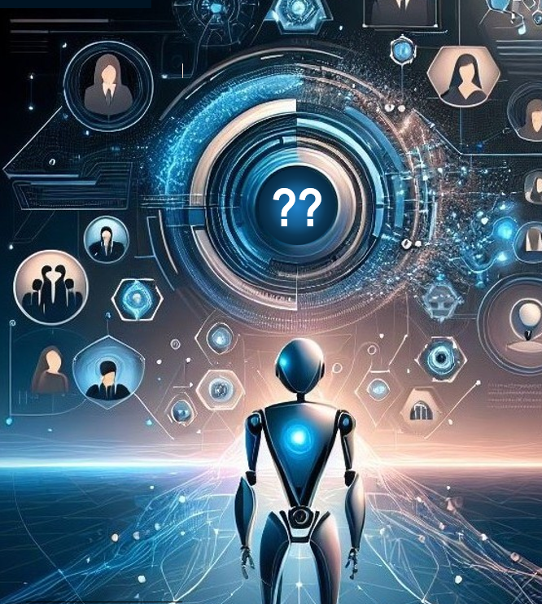
“Agentic AI” Industry Definitions
Bryan Stearns, stearns@umich.edu
45th Soar Workshop, May 5th 2025

Slide 2



Background
AGENTIC AI!!!!!
Working in large healthcare tech enterprise
All business leaders want to stay on top of technology trends
Trend of 2025: “Agentic AI!!!”

Slide 3


Background: Motivation
AGENTIC AI!!!!!
But what is “Agentic AI”???
Everyone gives a different answer
Leaders are tasked with equipping their teams with new tech
Leaders not equipped to know what they need
Software vendors get to pitch silver bullets

Slide 4
Conflicting Definitions of “Agent”
“An artificial intelligence (AI) agent is a software program that can interact with its environment, collect data, and use the data to perform self-determined tasks to meet predetermined goals. … AI agents are rational agents. They make rational decisions based on their perceptions and data to produce optimal performance and results. An AI agent senses its environment with physical or software interfaces.” – AWS (Agents Landing Page)
“Agents are software robots that use new AI skills to accomplish more complex tasks by including abilities for task planning and autonomous decision making.” – 2025 UiPath Agentic AI Report
“Agents are applications that use generative AI models to think and act towards goals.” – Kurtis Van Gent (Software Engineer, Google GenAI Toolbox), Neo4j Live Interview
“So you take an LLM, you give it some tool-calling capabilities, you give it the ability to execute the results of those tool calls, and then you have an agent, and I feel like I'm happy with that base definition.” – Dr. Victor Dibia, Principal RDSE at Microsoft Research (Generative AI, Agents), TWIML AI Podcast Interview
“Agents don’t just respond to user input. Instead, they can process a complex problem such as an insurance claim from start to finish. … The agents do this autonomously — without humans having to check whether the AI is processing everything correctly. … In contrast to existing AI systems and all the copilots out there that help employees to do their job, AI agents are, in fact, fully-fledged employees themselves.” – Medium: What Are AI Agents A Short Intro And A Step-by-Step Guide to Build Your Own

Slide 5

Who is Right??
“The confusion in the marketplace over what 'agents' are is even worse than the previous confusion over what 'AI' is. … At least with 'AI' there were some definitions we generally agreed on. Now everyone is just calling every piece of software agentic and there is no common understanding to fall back on.”¹
Ethan Mollick, Associate Professor at The Wharton School and author of Co-Intelligence
¹See https://www.forbes.com/sites/jodiecook/2025/03/14/what-is-an-ai-agent-5-practical-ways-to-use-them-in-your-business/

Slide 6
Outline
Part 1: The leading uses of “agent” in industry
Textbook Agent
Multi-Agent Agent
Human-like Decision Agent
LLM Agent
Part 2: Can we bring them together?
Proposal and Discussion

Slide 7




Leading Senses of “Agent”
Textbook Agent
“Just read Russel & Norvig’s AI A Modern Approach.”
Multi-Agent Agent
“Agents are the parts of multi-agent systems!”
Human-like Decision Agent
“Can’t put my finger on it, but it’s like how humans can do…”
LLM Agent
“Agents are LLMs that can take actions using tools.”

Slide 8
Conflicting Definitions of “Agent”
“An artificial intelligence (AI) agent is a software program that can interact with its environment, collect data, and use the data to perform self-determined tasks to meet predetermined goals. … AI agents are rational agents. They make rational decisions based on their perceptions and data to produce optimal performance and results. An AI agent senses its environment with physical or software interfaces.” – AWS (Agents Landing Page)
“Agents are software robots that use new AI skills to accomplish more complex tasks by including abilities for task planning and autonomous decision making.” – 2025 UiPath Agentic AI Report
“Agents are applications that use generative AI models to think and act towards goals.” – Kurtis Van Gent (Software Engineer, Google GenAI Toolbox), Neo4j Live Interview
“So you take an LLM, you give it some tool-calling capabilities, you give it the ability to execute the results of those tool calls, and then you have an agent, and I feel like I'm happy with that base definition.” – Dr. Victor Dibia, Principal RDSE at Microsoft Research (Generative AI, Agents), TWIML AI Podcast Interview
“Agents don’t just respond to user input. Instead, they can process a complex problem such as an insurance claim from start to finish. … The agents do this autonomously — without humans having to check whether the AI is processing everything correctly. … In contrast to existing AI systems and all the copilots out there that help employees to do their job, AI agents are, in fact, fully-fledged employees themselves.” – Medium: What Are AI Agents A Short Intro And A Step-by-Step Guide to Build Your Own

Slide 9
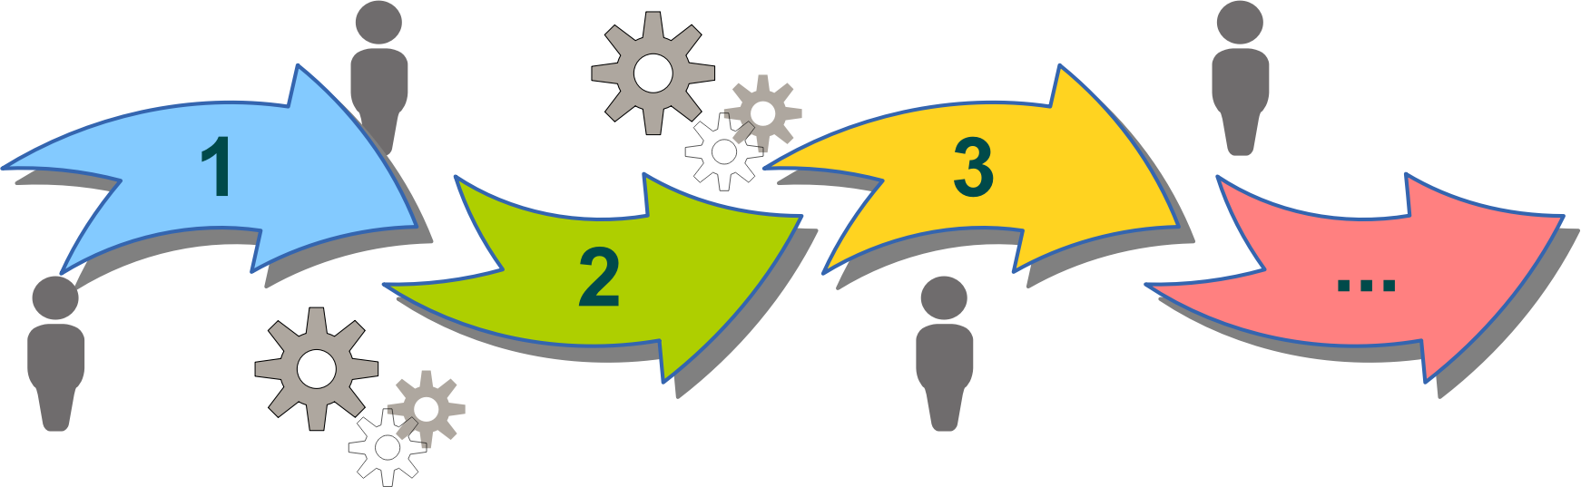
Dominant Contender Is…
LLM Agent is by far the most common definition in industry chatter now
Business / IT persons usually inform themselves through podcasts / vlogs
Source maybe not qualified, but charismatic
“Agents now change everything! Listen to my episode to be prepared!”
Becomes language assumed within industry community
Tech experts then conform to communicate with business
“You want agents? Sure, we’ll give you agents!”
“Agents are applications that use generative AI models to think and act towards goals.”

Slide 10
Problem with New Terminology
Language changes all the time.
Why not embrace the new terminology as it becomes dominant?
LLM definition in the same technical context (AI tech) as prior definitions
Particularly: Dominant Russel & Norvig Textbook definition
Context can’t differentiate which sense is meant!
Have to rename prior AI “agent” software to conform to new definition?
Need different context to make new definition without confusion
Computer networking has own sense of “agent” that has happily coexisted.¹
Is a special context within technology conversations
¹See https://cyber.harvard.edu/archived_content/people/reagle/agents-19990524.html#_Etymology

Slide 11
Part 1: The Leading Uses of “Agent”
Textbook Agent
“Just read Russel & Norvig’s AI A Modern Approach.”
Multi-Agent Agent
“Agents are the parts of multi-agent systems!”
Human-like Decision Agent
“Can’t put my finger on it, but it’s like how humans can do…”
LLM Agent
“Agents are LLMs that can take actions using tools.”

Slide 12
The “Textbook Agent” Sense
Textbook Agent
“Just read Russel & Norvig’s AI A Modern Approach.”
Multi-Agent Agent
“Agents are the parts of multi-agent systems!”
Human-like Decision Agent
“Can’t put my finger on it, but it’s like how humans can do…”
LLM Agent
“Agents are LLMs that can take actions using tools.”
“They make rational decisions based on their perceptions and data to produce optimal performance and results.”

Slide 13
Textbook Agent¹
Agent: “An agent is just something that acts (agent comes from the Latin agere, to do).… An agent is anything that can be viewed as perceiving its environment through sensors and acting upon that environment through actuators”
Rational Agent: An agent “that acts so as to achieve the best outcome or, when there is uncertainty, the best expected outcome.”
Artificial Intelligence (as a field): The study and creation of rational agents.
¹Quotations from Artificial Intelligence: A Modern Approach, Global Edition – 4th edition (Russel & Norvig, 2021)

Slide 14
Textbook Agent¹: Implications
So what counts as an “agent”?
“One could view a hand-held calculator as an agent that chooses the action of displaying ‘4’ when given the percept sequence ‘2 + 2 =’ …“
“In a sense, all areas of engineering can be seen as designing artifacts that interact with the world; AI operates at (what the authors consider to be) the most interesting end of the spectrum, where the artifacts have significant computational resources and the task environment requires nontrivial decision making.”
¹Quotations from Artificial Intelligence: A Modern Approach, Global Edition – 4th edition (Russel & Norvig, 2021)

Slide 15

Textbook Agent: Why Use the Term?
If the term could include anything with I/O, why use it at all?
Useful in context of the environment
Example: Rosie the Robot
From Rosie’s perspective, is an AI performing a task
From the world’s perspective, one of potentially many interacting “agents”

Slide 16
Textbook Agent: The Logical Conclusion?
“But I think of ‘agent’ as ‘something that does stuff for me on its own.’
(Maybe with the ability to do multiple steps of actions on its own.)
This actually reduces to a Textbook Agent
Calculators generate results for you on their own
Calculators internally use multiple steps of operation
Must use the same definition for all environments
Not just those with physically-interactive actions.
Unless we can find a better definition?

Slide 17
The “Multi-Agent Agent” Sense
Textbook Agent
“Just read Russel & Norvig’s AI A Modern Approach.”
Multi-Agent Agent
“Agents are the parts of multi-agent systems!”
Human-like Decision Agent
“Can’t put my finger on it, but it’s like how humans can do…”
LLM Agent
“Agents are LLMs that can take actions using tools.”
“This is how agents work. . . .”

Slide 18
Multi-Agent Agent
Is it a circular definition?
“Something that’s part of a system that has agents.”
It doesn’t have to be:
“An entity that collaborates with other entities to achieve a common goal.”
Most encountered as a passive assumption rather than as a formal definition
Usually from non-technical persons

Slide 19
Multi-Agent Agent: Not Robust
Where do you draw the line?
Good practice usually breaks apps into encapsulated components
Are they each agents?
A sumo robot’s opponent is interacting, but not cooperating on a common goal
Are sumo robots each agents?
The Multi-Agent definition is rarer and does not hold up well

Slide 20
The “Human-like Decision Agent” Sense
Textbook Agent
“Just read Russel & Norvig’s AI A Modern Approach.”
Multi-Agent Agent
“Agents are the parts of multi-agent systems!”
Human-like Decision Agent
“Can’t put my finger on it, but it’s like how humans can do…”
LLM Agent
“Agents are LLMs that can take actions using tools.”
“agents [work] autonomously — without humans having to check whether the AI is processing everything correctly. … AI agents are, in fact, fully-fledged employees themselves.”

Slide 21
Human-like Decision Agent
Not a single definition, but a vague class of definitions:
Agent: “Something that achieves this aspect of autonomy that humans do well.”
Common variants:
Self-directed: Decides how to arrange and execute sub-goals to achieve a given goal
Highly interactive: Responds to continuous input to adapt decision making in real-time
Turing: Understands inputs and/or performs outputs in a human-like way
Unifying thread:
Imitates some aspect of human internal processing
But until we understand human internal processing, hard to make technically precise

Slide 22
Human-like Decision Agent: Difficulties
Self-directed: Decides how to arrange and execute sub-goals to achieve a given goal
Agreeable: Assign robot to fold laundry and it figures out how
Debatable: Assign router to manage network traffic and it figures out how
Highly interactive: Responds to continuous input to adapt decision making in real-time
Agreeable: Juggling robot needs to adapt actions in real time
Debatable: Internet research chatbot doesn’t need to sync with external clock.
Turing: Understands inputs and/or performs outputs in a human-like way
Agreeable: Tasks that human typically perform
Debatable: Tasks that humans do poorly/slowly, like spreadsheet calculations
Easier to agree that something is an agent when it’s doing a physically interactive task
Harder to get consensus when the task is more virtual / abstract
AI is usually in the realm of abstract software in practice

Slide 23
The “LLM Agent” Sense
Textbook Agent
“Just read Russel & Norvig’s AI A Modern Approach.”
Multi-Agent Agent
“Agents are the parts of multi-agent systems!”
Human-like Decision Agent
“Can’t put my finger on it, but it’s like how humans can do…”
LLM Agent
“Agents are LLMs that can take actions using tools.”
“So you take an LLM, you give it some tool-calling capabilities, you give it the ability to execute the results of those tool calls, and then you have an agent, and I feel like I'm happy with that base definition.”

Slide 24
LLM Agent
Defines “agent” in terms of internal design rather than external function.
Is specific and constrained:
Reduces “agent” to software that uses LLM(s) as decision making algorithms
LLM Agents typically programmed through prompt templates
“You are an expert writer. Write an essay about {topic}.”
Often implicitly combined or equivocated with other senses of “agent”
Described with Russell & Norvig’s classification of 5 types of agents
Described as equivalent to multi-agent system
Described as equivalent to tech that replaces skilled human workers

Slide 25
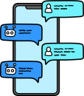
LLM Agent: Differentiate Agents By Prompts?
It can be tricky to define how to distinguish one agent from another.
One option: “They’re different agents if they use different prompt templates”
Write about “flavonoids” – Agent A
Write about “free radicals from non-ionizing radiation” – Agent A
Review this article for grammar – Agent B
But what if you run one prompt with two tasks in parallel?
Is it still a single agent doing two things at once?
“That doesn’t sound right….”

Slide 26

LLM Agent: Differentiate Agents By Processing?
Another option: “They’re different agents if they run different tasks”
Write about “flavonoids” – Agent A
Write about “free radicals from non-ionizing radiation” – Agent B
Review this article for grammar – Agent C
But then every use of one template is a new agent.
“That doesn’t sound right either.”

Slide 27

LLM Agent: Differentiate Agents By Memory?
Another option: “It’s the same agent if it maintains the same memory state”
Parallel uses are different agents
Sequential uses could be the same agent
Example: Chat-bot that maintains conversation history
But many “LLM Agents” don’t have individual state memory across tasks.
Many systems might incorporate shared memory
For LLMs to chain I/O or to access user context
Chat-bots might have conversation history, but most “agentic” examples aren’t chats
Thus, this reduces to the “Processing” option in practice, but arguably is more satisfying

Slide 28

Outline
Part 1: The leading uses of “agent” in industry
Textbook Agent
Multi-Agent Agent
Human-like Decision Agent
LLM Agent
Part 2: Can we bring them together?
Proposal and Discussion

Slide 29

Two Different Aims
Textbook Agent definition:
Consistent and robust: Useful for technical conversation
Not satisfying – too broad
Non-Textbook Agent definitions:
Not very robust when pushed to their limits
More satisfying
Given we have the chaos of competing definitions:
Find common ground across the different camps?
Make a definition that satisfies both aims?

Slide 30

Proposed Definition
Agentic: When something acts to change the I/O relationship that it has with its outside environment.
Comparison with Textbook Agent definition:
Similar: Based on presence of I/O with environment
Dissimilar: Requires particular kind of output to be present

Slide 31
Comparison of Definitions
“When something acts to change the I/O relationship that it has with its outside environment.”
 | Textbook Agent | Multi-Agent | Human-like Agent | LLM Agent | Proposed Agent
Robot that folds laundry | ✓ | ✗ | ✓ | ✗ | ✓
Laptop sitting on table | ✓ | ✗ | ? | ✗ | ✗
LLM-based tool-using app | ✓ | ? | ? | ✓ | ✓
Network Router | ✓ | ✗ | ✗ | ✗ | ✗
Compute server clusters | ✓ | ✓ | ✗ | ✗ | ✗

Slide 32



Example 1: 3D World
Two entities that perform I/O in a 3D world
Laptop computer
Walking robot
Laptop input constrained by where/how it is used
Camera can only “see” what’s in field of view
Output constrained to screen and speakers
Robot can choose to move
Changes the space of inputs it can receive
Changes the space of objects it can manipulate
The robot might pick up and move the laptop, but the laptop doesn’t cause the change.
The laptop lacks “agency”

Slide 33
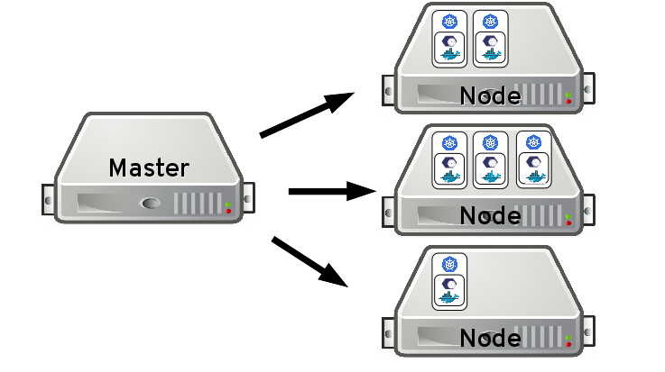
Example 2: Virtual Network
Two entities that perform I/O in a network environment:
Managed compute server cluster
Modern “agentic” LLM software
Cluster I/O constrained to its orchestration environment
Master/slave job allocation, memory allocation, etc.
LLM software can choose to use tools that let it change its I/O
Navigate internet to find new articles to read or new web forms to output to
The cluster might get connected to new log streams, but it doesn’t cause the change
The cluster lacks “agency”.

Slide 34


First Derivative: Change in I/O Space
Distinction:
Current I/O space
What the robot can ever see if it stays put
Space of I/O spaces that can be reached with known actions
What the robot can ever see anywhere it can currently move
The space of change is constrained:
A robot can only walk the surface of the ground if it has legs or wheels
Legs won’t let it fly – it cannot explore the sky
If the robot got stuck in mud, it could no longer move – it loses agency!
An LLM agent can only crawl the internet if given a “tool” that enables that
An internet-crawl tool will not let it pour my coffee
If the LLM only has tools for simple math, it cannot change its I/O space – it lacks agency!

Slide 35


Second Derivative: Change in Possible Changes
Distinction:
Space of I/O spaces that can be reached with known actions
What the robot can ever see anywhere it can currently move
Space of I/O spaces that can be reached with actions that can be learned
What the robot can ever see anywhere it can learn to move
Say the robot is stuck in mud, but it has a shovel
Could be used to free its legs, IF it knows how to use it
If it cannot use the shovel, it still lacks agency
If it can learn to use the shovel, it can gain agency!
If it can learn how to build a jetpack, it can also then fly!
Implication: Learning can enable agency
Learning actions within one’s starting I/O space can unlock changes to that I/O space
Not all learning unlocks new changes

Slide 36
Oversight Loopholes?
Want guarantees that deployed AI won’t learn bad behavior!
Want to define / constrain space of possible future I/O
Typically enforced by turning off learning before deployment
If agents can gain use of new tools after deployment, all bets are off!
Agent behavior could change even if training is locked in!
Takeaway:
Governance and oversight involve both learning and tool availability.

Slide 37

Derivative Takeaways
Definition seems to hold together when pushed to its limits
Offers conceptual connections regarding agency and learning
It is up to the AI developer to responsibly give AI:
Right tools for the spaces it can explore
Right constraints for what it can learn to use

Slide 38


Conclusion
Nuggets
Coal
Recognizing different “Agentic AI” definitions helps navigate confusing conversations
Pinning down definitions helps explore how robust they are when pushed to limits
Proposed definition for potentially unifying different schools of thought
“Agentic” term confusion isn’t going away soon!
Presented definitions are characterizations
Usage in practice can vary
Proposed definition adds to the many
But a new unifying definition that satisfies public sensibilities might be the only way to remove the existing conflict
Proposed definition has not been put to the test
Discuss! ☺

